Slide 1
QTL Mapping with both Mixed and Multivariate Models
Lauren Vanderlinden
Saba Lab Meeting
March 13, 2017

Slide 2
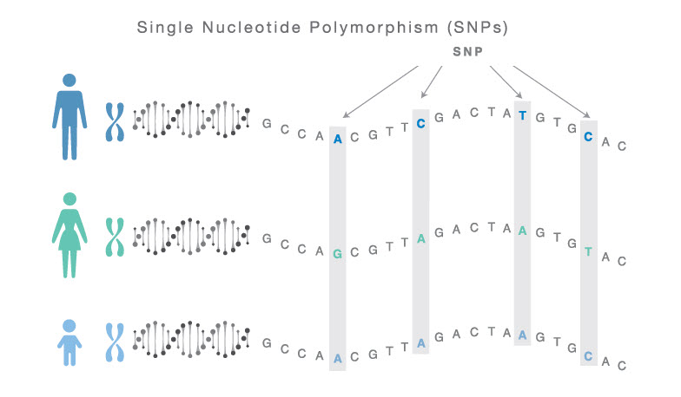
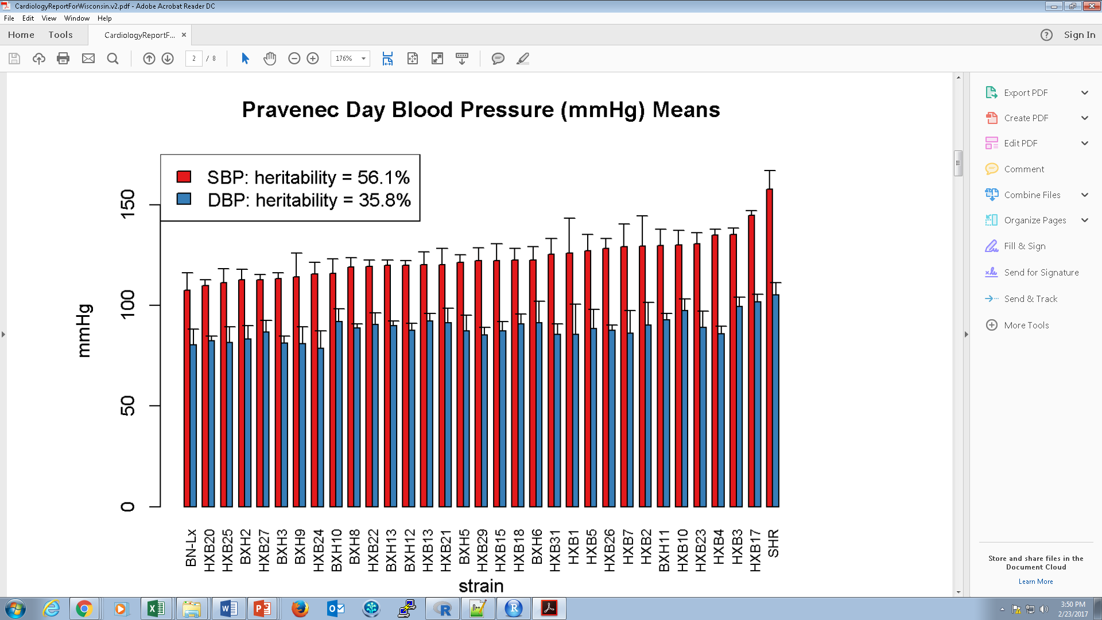
QTL Analysis Overview
Marker Set
Quantitative Trait Locus (QTL) Analysis
Finding a locus (section of DNA) which correlates with variation in a quantitative trait (phenotype of interest).
Examples of phenotypes we have used have been RNA expression (eQTL), behavioral measures (amount of EtOH consumed, bQTL), physiological measures (blood pressure, pQTL).
Goal is to find the genetic control of the phenotype we are interested in.
https://www.natera.com/science-informatics
Quantitative Trait

Slide 3
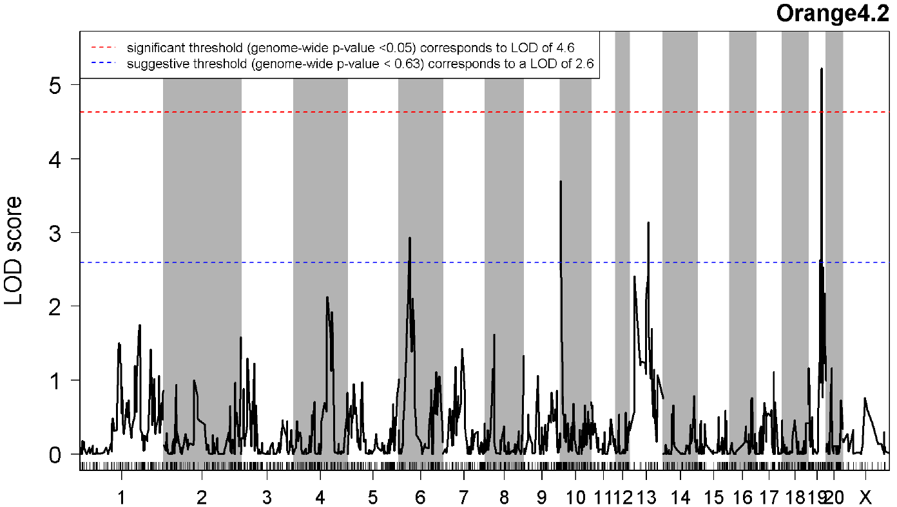
Simple Marker Regression
Design | Potential Genotypes
Recombinant Inbred | A/A & a/a
Backcross | Scenario 1: A/a & A/A Scenario 2: A/a & a/a
Intercross | a/a, A/a, & A/A
Consider each marker individually
qtl package in R (Karl Broman)
scanone() function
Backcross, use a t-test (I use a backcross assumption)
Intercross uses an ANOVA
Traditionally uses a LOD score to measure significance
log10 likelihood ratio comparing the hypothesis that there is a QTL at the marker to the hypothesis that there is no QTL anywhere in the genome

Slide 4
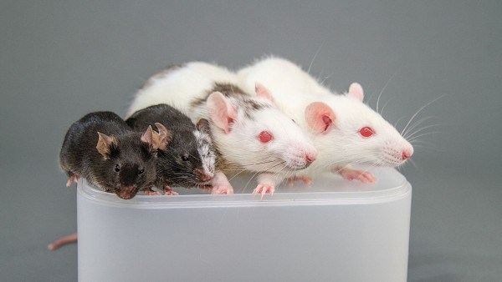
Why Explore New Methods?
Expanding from RI panel to hybrid rat diversity panel (HRDP)
Good: more strains (going from 30 RI strains to 60 total), therefore more power. Possibly more diversity in our phenotypes we are looking at.
Bad: strains no longer have the same type of relationship to each other
Interested in Multivariate Methods
Many times, not just interested in 1 phenotype.
Example 1: blood pressure. Pravenec measured day time, night time, SBP and DBP. What measure do we use to represent blood pressure?
Example 2: 2-bottle choice (2BC) drinking in the BXD’s. We have expression data on a BXD RI panel, but got the 2BC phenotype from 2 different labs (Rodriguez et al., 1994 included 21 strains and Phillips et al., 1994 included 19 strains). Which lab’s data do you use?
These phenotypes aren’t independent from one another
https://ipscell.com/tag/hiromitsu-nakauchi/

Slide 5
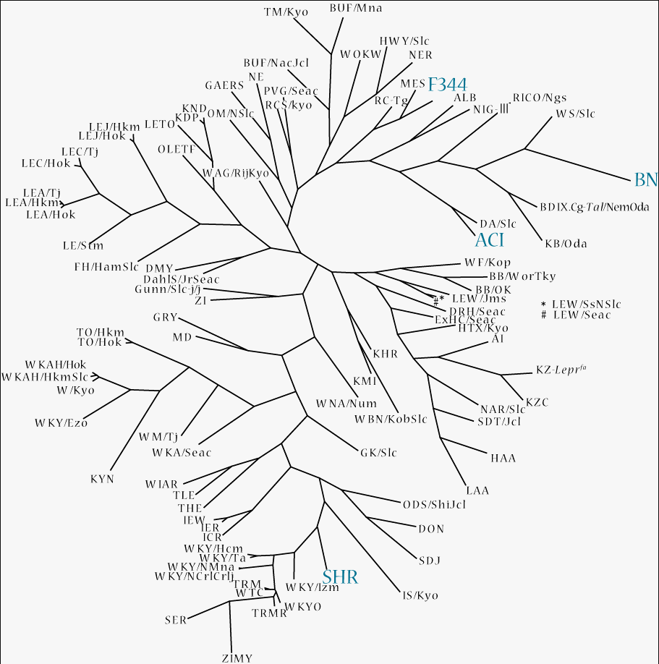
Problem 1: Population Stratification
Genetic Variant
(SNP)
?
Phenotype
Confounding by ethnicity
Differences in allele frequencies due to differences in ancestry rather than association of genes with disease
Non-random mating between groups
Different relationships between each combination of strain (admixture)
True for the HRDP
In humans, physical separation (say African vs European descent)
Genetic drift of allele frequencies in each group
Ethnicity
http://www.anim.med.kyoto-u.ac.jp/NBR/Images/phylogenetic_tree_132_200_2.png

Slide 6
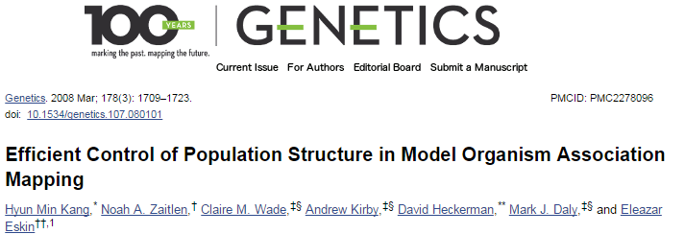
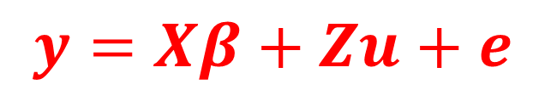
EMMA: Adjustment for Population Stratification
$$y=Xβ+Zu+e$$
Efficient Mixed-Model Association (EMMA)
http://mouse.cs.ucla.edu/emma/
From Eleazar Eskin’s lab at UCLA (PMID: 18385116)
R package
Warning!!! There is another emma package in R as well (Evolutionary model-based multiresponse approach). Please download directly from Eskin’s website
Spencer installed the correct version on sysgen
Where:
n is the # measurements of a phenotype
t is the # of inbred strains
q is the # of fixed effect parameters
y is the n x 1 vector of phenotypes
X is the n x q fixed-effects design matrix including: mean, SNPs and any confounders
β is the q x 1 vector of fixed coefficients
Z is the n x t incidence matrix mapping each measured phenotype to 1 of the t inbred strains
u is the t x 1 random effects
e is the n x n residual effects

Slide 7
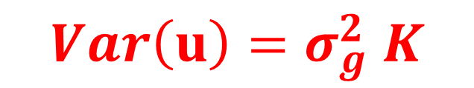
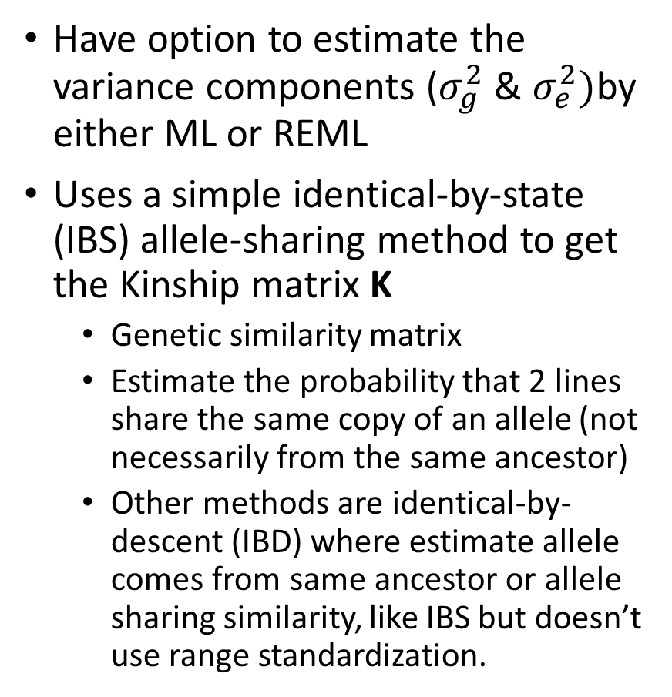
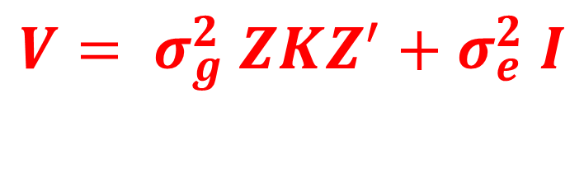


EMMA Continued…
$$y=Xβ+Zu+e$$
Have option to estimate the variance components ($σ_{g}^{2}$ & $σ_{e}^{2})$by either ML or REML
Uses a simple identical-by-state (IBS) allele-sharing method to get the Kinship matrix K
Genetic similarity matrix
Estimate the probability that 2 lines share the same copy of an allele (not necessarily from the same ancestor)
Other methods are identical-by-descent (IBD) where estimate allele comes from same ancestor or allele sharing similarity, like IBS but doesn’t use range standardization.
$$Var\left(u\right)=σ_{g}^{2} K$$
K is the t x t kinship matrix inferred from genotypes
$$Var\left(e\right)=σ_{e}^{2} I$$
$$V= σ_{g}^{2} ZKZ^{′}+σ_{e}^{2} I$$
V is the overall phenotypic variance-covariance matrix

Slide 8
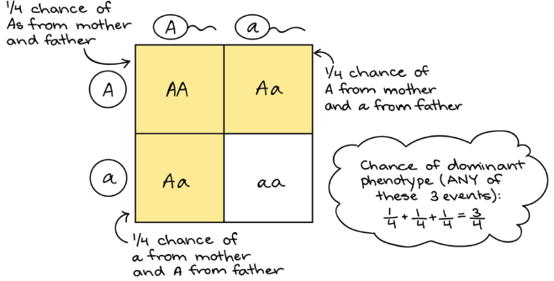
qtl2 R package
An updated package from Karl Browman
Still in development, so not available on CRAN
Can install from: https://github.com/kbroman/qtl2
Big pro: very similar to R/qtl, also calculated H2
It’s split up into 3 parts:
qtl2geno: genotype probability calculations
qtl2scan: QTL scans
qtl2plot: visualization
Also uses a linear mixed model with a kinship matrix
3 options to calculate a kinship matrix, one using all chromosomes, a chromosome specific one and another using LOCO (leave 1 chromosome out)
Looks like from code they are using IBS as they aren’t assuming where allele comes from, but this is still a little unclear to me
https://www.khanacademy.org/science/biology/classical-genetics/mendelian--genetics/a/probabilities-in-genetics

Slide 9
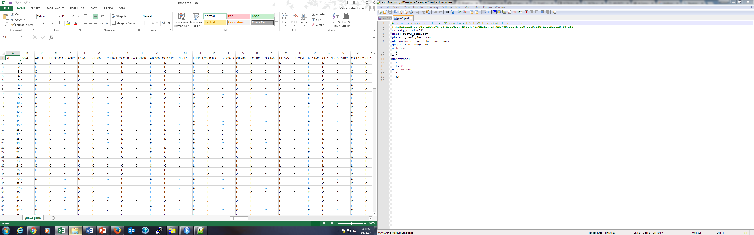
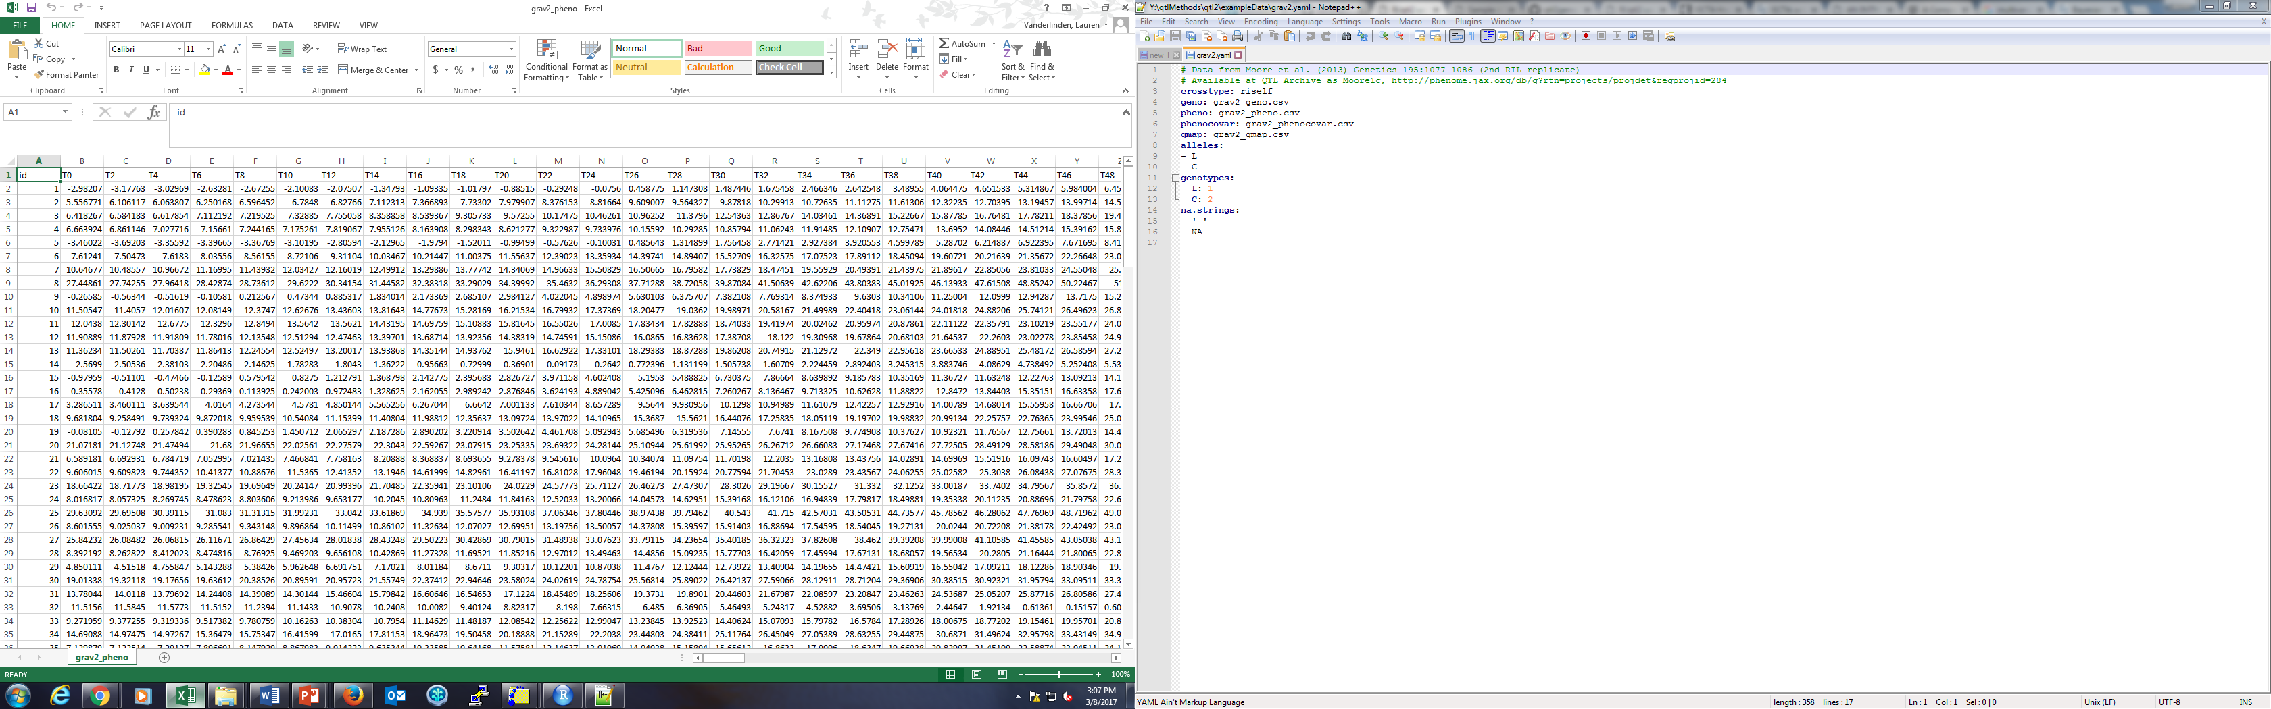
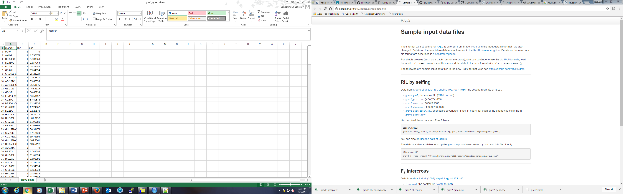
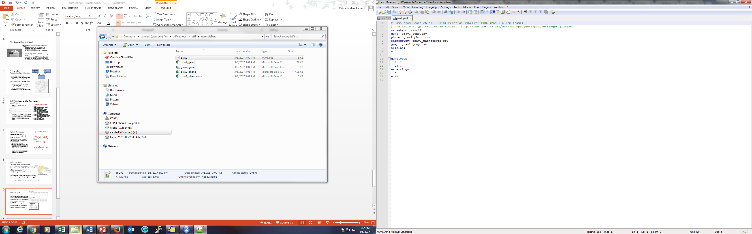
Data for qtl2
genotype
Genotype file (csv): each sample a row and each column a marker
Phenotype file (csv): each sample a row and each column a phenotype
Genetic map (csv): 3 columns: marker name, chr and position
Control File (yaml): info on files you are using for the genotype, phenotype, map and alleles, genotypes and missing calls
phenotype
genetic map
control

Slide 10
Problem 2: Multiple Phenotypes
qtl2 does NOT currently have a multivariate mixed model to handle both population stratification and multiple phenotypes, but Karl posted he is interested in doing this and is working on this.
We currently use PLINK for calculating the eQTLs for PhenoGen. Good high throughput method
THANK YOU SPENCER!!!
Ideally have something that can account for BOTH population stratification and multivariate analysis
Want to find a multivariate approach which models multiple outcomes simultaneously
Also gives us more power
Many types of software out there, but not necessarily R packages
GEMMA
GCTA-MLMA
PLINK
SNPTEST
MultiPhen
BIMBAM
dlmap (R package)
qtlbim (R package)

Slide 11
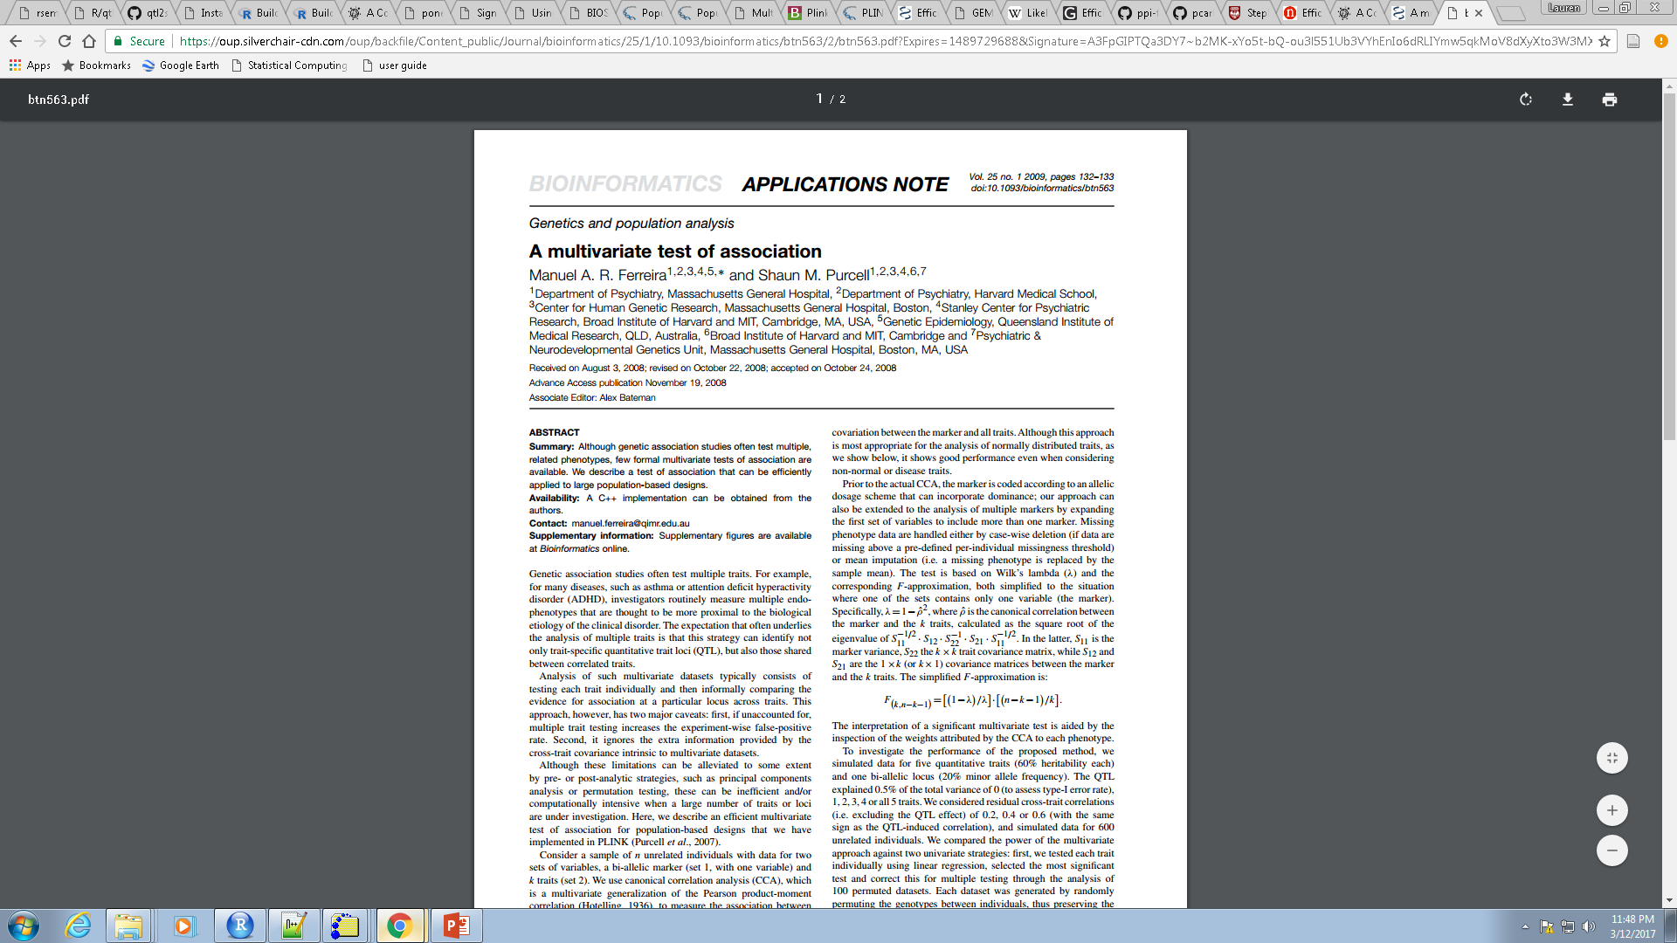
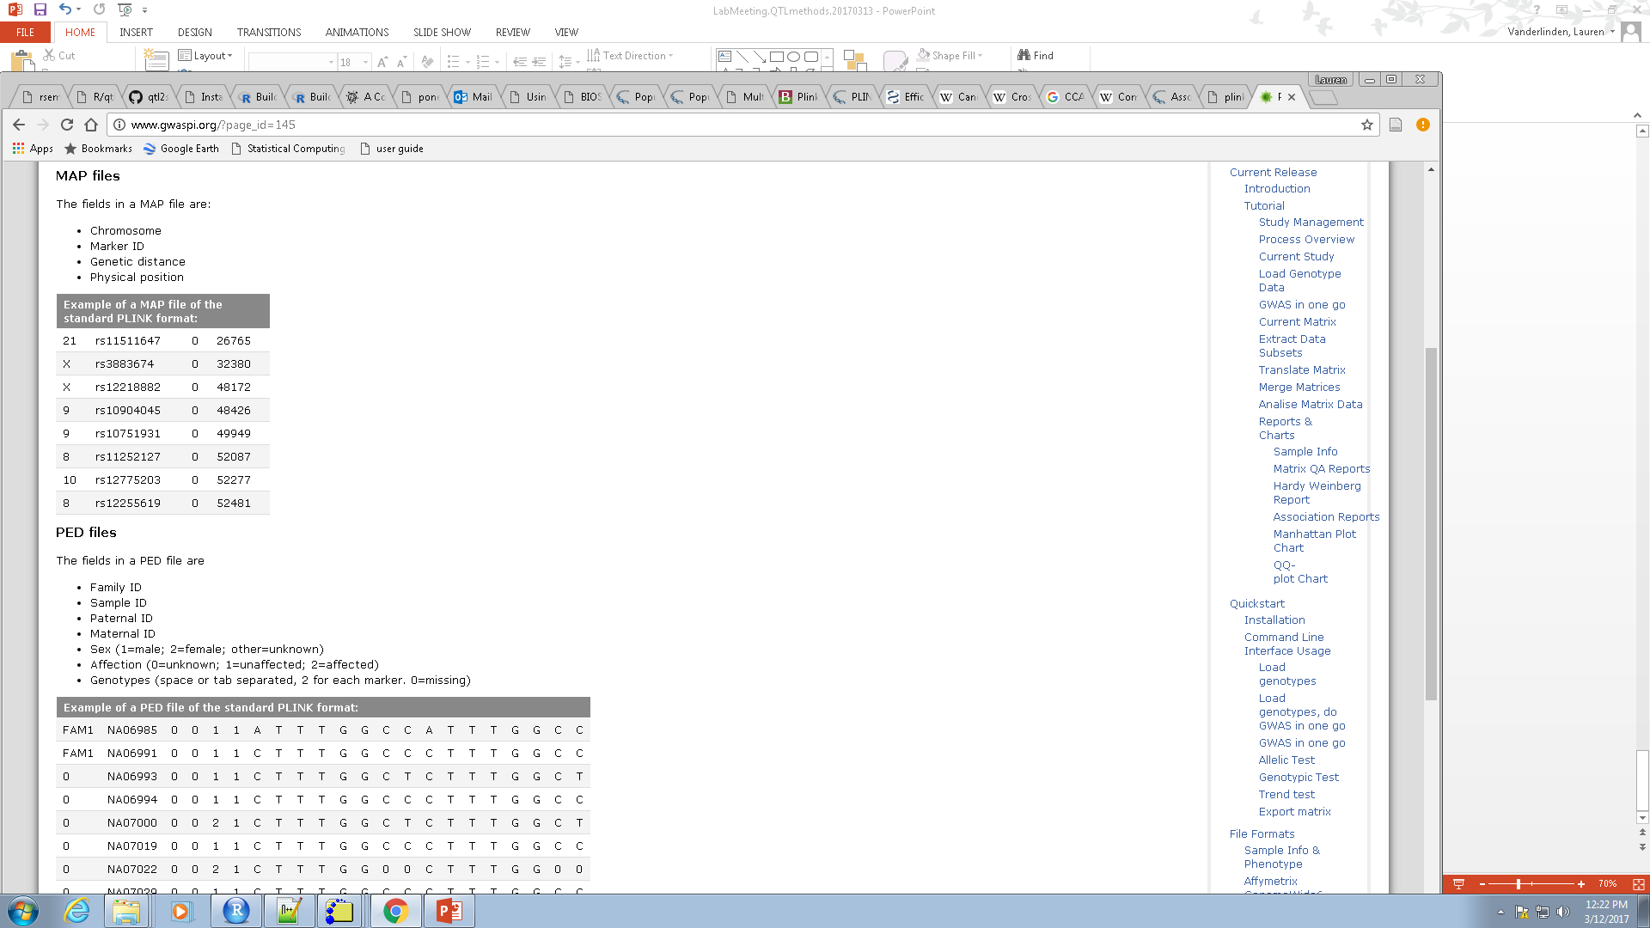
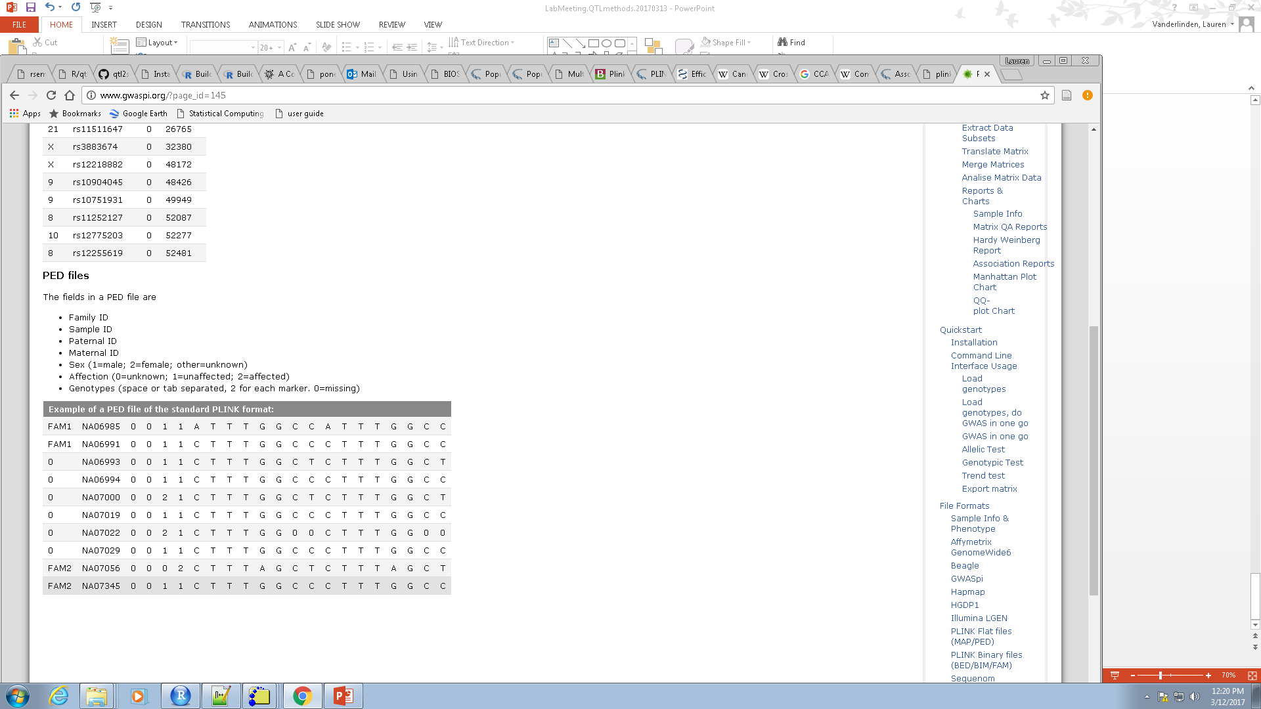
PLINK
Ped, map files
plink.multivariate –noweb --file geno --mqfam --mult-pheno pheno.phen --out output
To account for population stratification:
--cluster
Uses IBS to perform complete linkage clustering (type of hierarchical clustering) and get a family structure file (--mqfam file)
BUT, papers I’ve read and forums don’t suggest plink for population stratification and to use a LMM

Slide 12
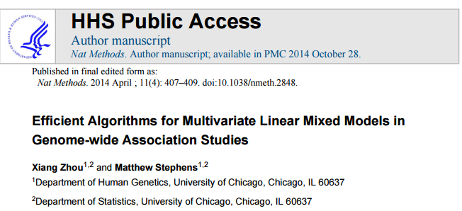
GEMMA
Same data input as plink
It is the multivariate version of EMMA
Give you the results from a likelihood ratio test (LRT)
Allows up to 1 covariate
2 types of optimization algorithm: an initial expectation-maximization–like (EM) algorithm, followed by a Newton-Raphson–like (NR) algorithm.
Stability of the EM algorithm (every iteration increases the likelihood) with the faster convergence of the NR algorithm
2 data sets tested on:
mouse GWAS from the Hybrid Mouse Diversity Panel (HMDP)
4 blood lipid phenotypes
small GWAS with strong relatedness among many individuals
human GWAS from the Northern Finland Birth Cohort 1966 (NFBC1966)
4 blood metabolic traits
larger GWAS with weak relatedness among most individuals
GEMMA faster than Wombat, MTMM and GCTA

Slide 13
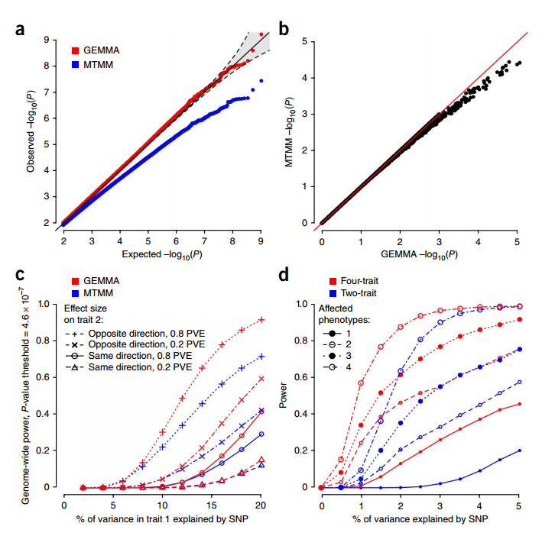
GEMMA vs MTMM
MTMM is a mvLMM, but differences are it can only handle 2 phenotypes and it only uses the EM optimization
1A: Q-Q plot for null simulated data. MTMM inflates p-values under the null, GEMMA doesn’t
1B: Comparing p-value in HMDP
1C: “4 different simulation scenarios based on HMDP data. x axis shows the percentage of phenotypic variance in the first phenotype explained (PVE) by the SNP, and symbols indicate the SNP effect direction (compared with its effect on the first phenotype) and size (quantified by PVE) on the second phenotype.”
1D: Gain in power with more phenotypes
Zhou et. al, 2014 Figure 1

Slide 14

Discussion
I think plink is too convoluted on not straight forward
qtl2 would be my preference, as I was able to install in R and run example data easily.
BUT…. qtl2 doesn’t have the multivariate part yet and we would be waiting on someone else to do the work.
GEMMA seems the most straight forward, has everything we want already built in
BUT… I haven’t played around with the software to be confident that I can actually make this run.

